Slide 1
Searching for sand reservoirs using 3C-3D seismic data, horizontal well logs, and VSP
Robert R. Stewart University of Houston
Chuandong (Richard) Xu Oxy Petroleum, California
Arnim Haase University of Calgary
AGL Update Meeting
Houston, Texas May 2nd, 2012

Slide 2
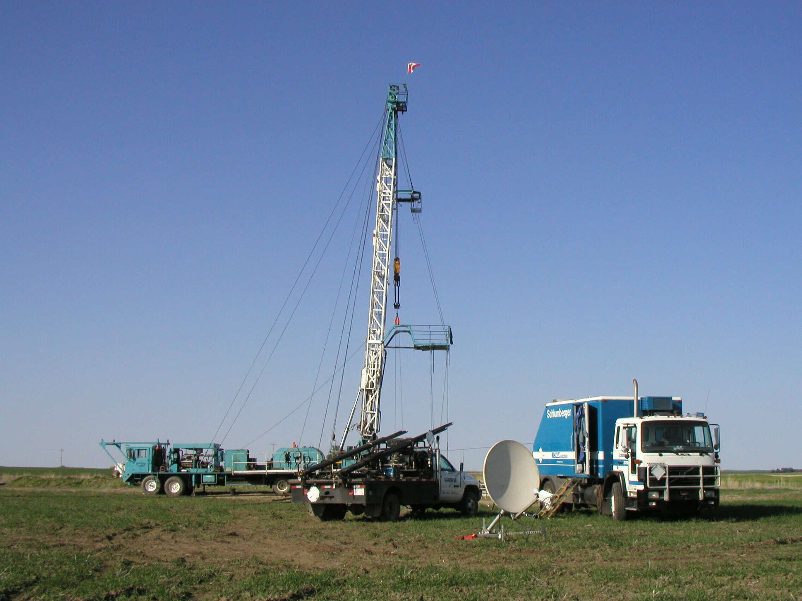
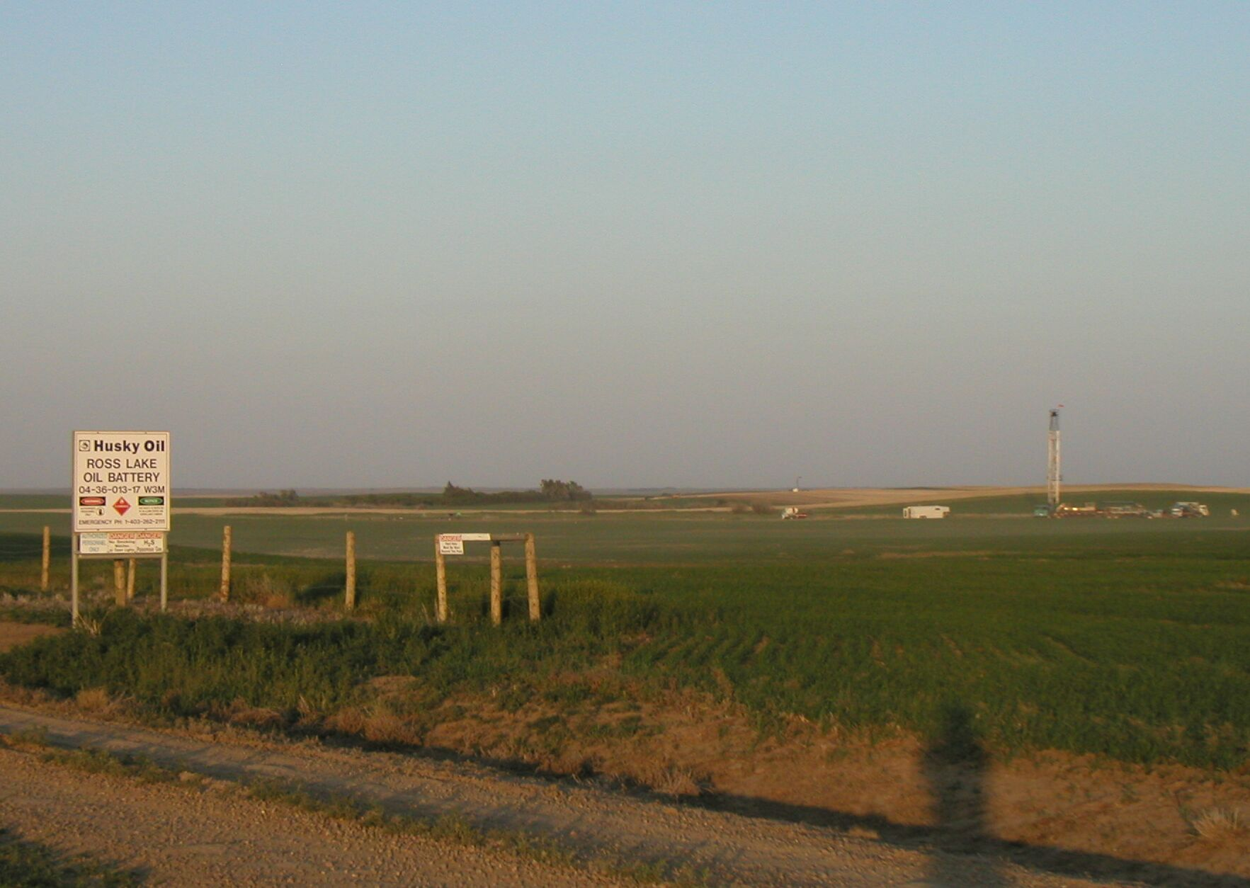
Outline
Introduction
Ross Lake, northern Williston Basin
Motivation – delineate reservoirs & find new ones
Geology - Stratigraphy & incised valley targets
Data - 3C-3D surface seismic and VSP
Analysis - Interpretation of PP & PS data
Time structure, time thickness, Vp/Vs
Results - Horizontal well logs
new targets

Slide 3
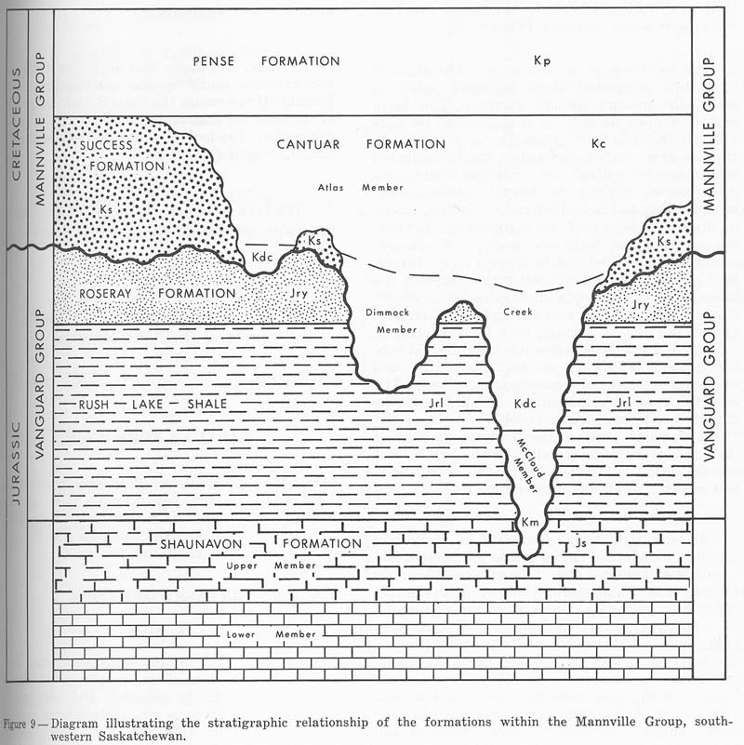
Geological Setting
Pense Fm
Cretaceous
Mannville Gp
Cantuar Fm
Success Fm
Roseray Fm
Vanguard Gp
Rush Lake Fm
Jurassic
Shaunavon Fm
(from Christopher, 1974)
Target: Sandbars in Dimmock Creek Member of the Cantuar Formation of Mannville Group, L. Cretaceous

Slide 4
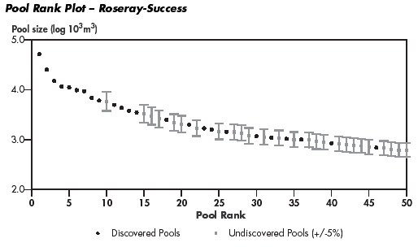
Motivation for continued &
improved exploration in the area
30 million barrel pool to be found
Numerous 10 million barrel pools
(Data from National Energy Board, 2001)

Slide 5
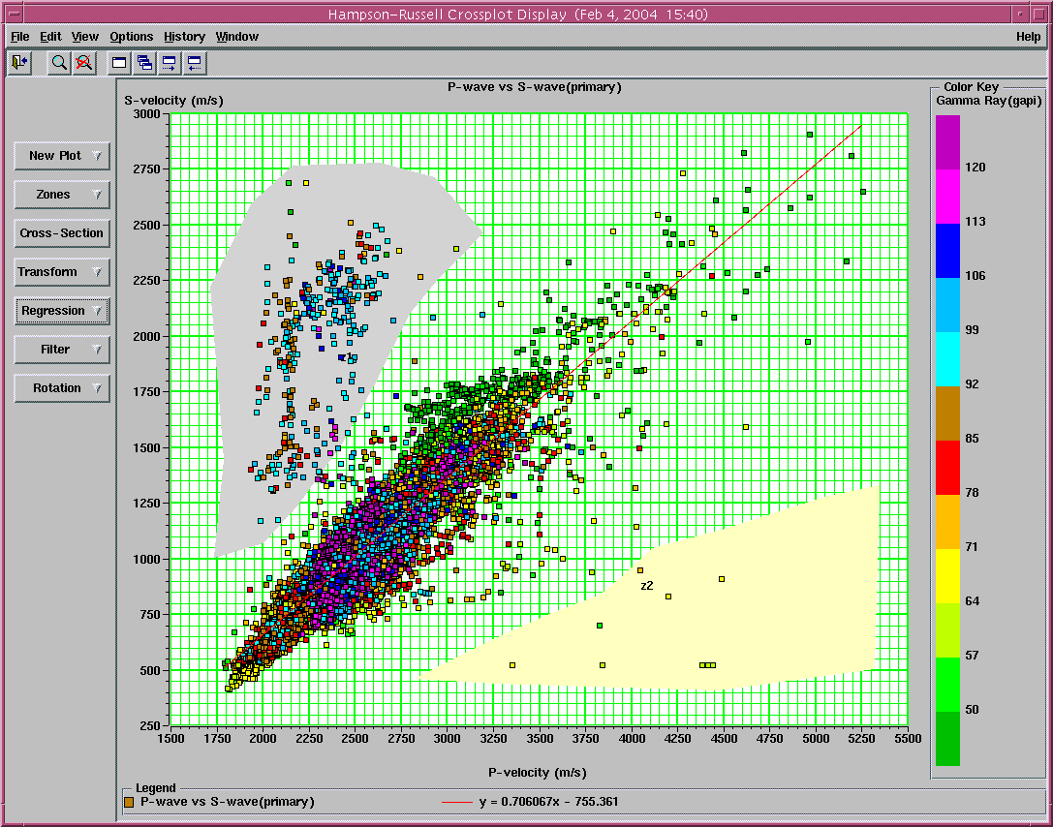
Crossplot of Vs and Vp from 4 regional wells
Regression: Vp=1.416*Vs+1070
Mudrock: Vp=1.16*Vs+1360
Vp/Vs=1.5
Vp/Vs=2.0
Vp/Vs=3.0

Slide 6
3C-3D seismic survey to locate horizontal well
Shot by CGGVeritas
Dynamite source, 3C VectorSeis® receivers
Record length: 5000 ms @ 2 ms sample rate
After processing, NS Inline 1-132, EW Xline 1-91, about 7.5 km²
25
Xline
Inline

Slide 7
Why are PS sections often lower frequency than PP sections? …. Attenuation
Q type | Spect. ratio | Drift | Empir | Conv/WE | Inst. Amp. | Average
Qp | 67 | 39 | 57 | 82 | 44 | 58
Qs | 23 | 37? | 11 | - | 28 | 25
From Best et al., 1994 and Calderon-Macias et al., 2004
* Q values from Ross Lake VSP

Slide 8
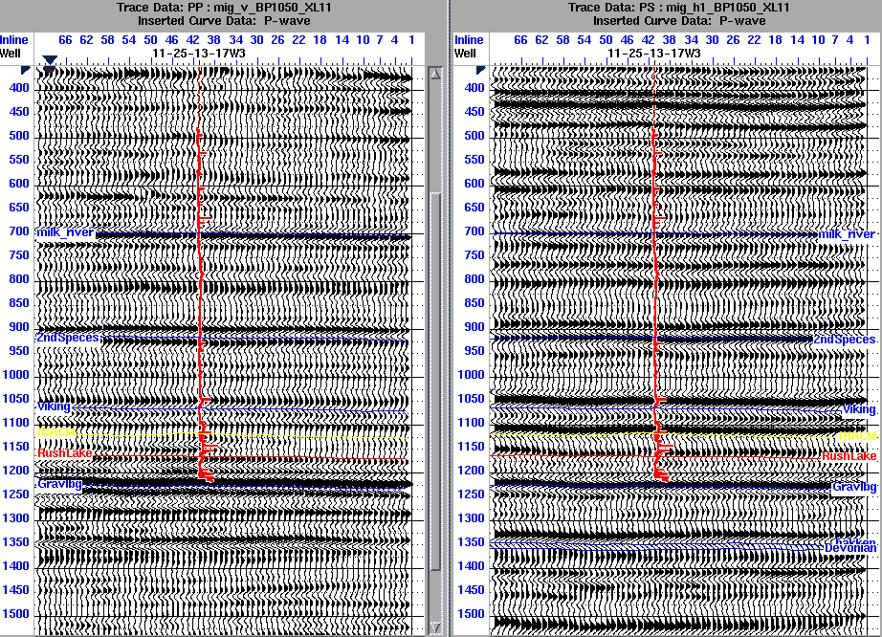
PP time, applied 5/10-50/60 bandpass filter
PP data
PS data, Vp/Vs=2.35 AND bulk shift UP 125ms
PP VSP (700m offset)
PS VSP (700m offset)

Slide 9
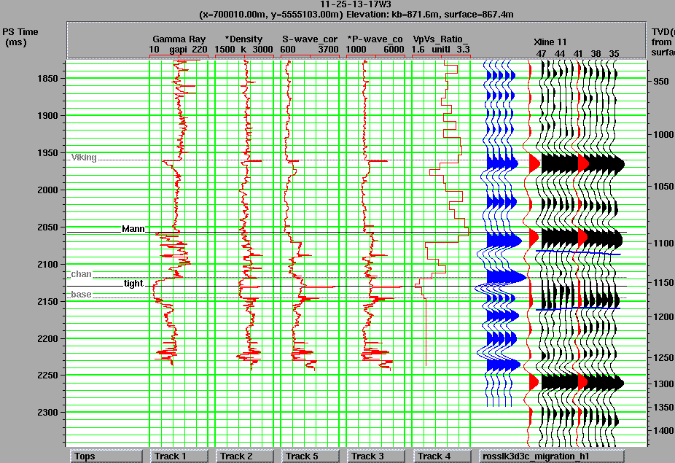
PP synthetic & section (PP time)
PS synthetic (PS time)

Slide 10
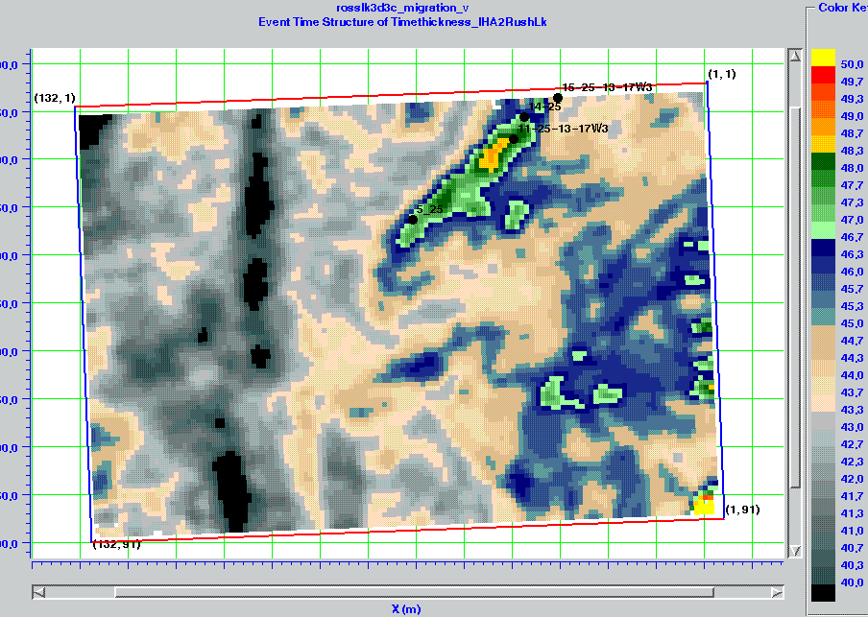
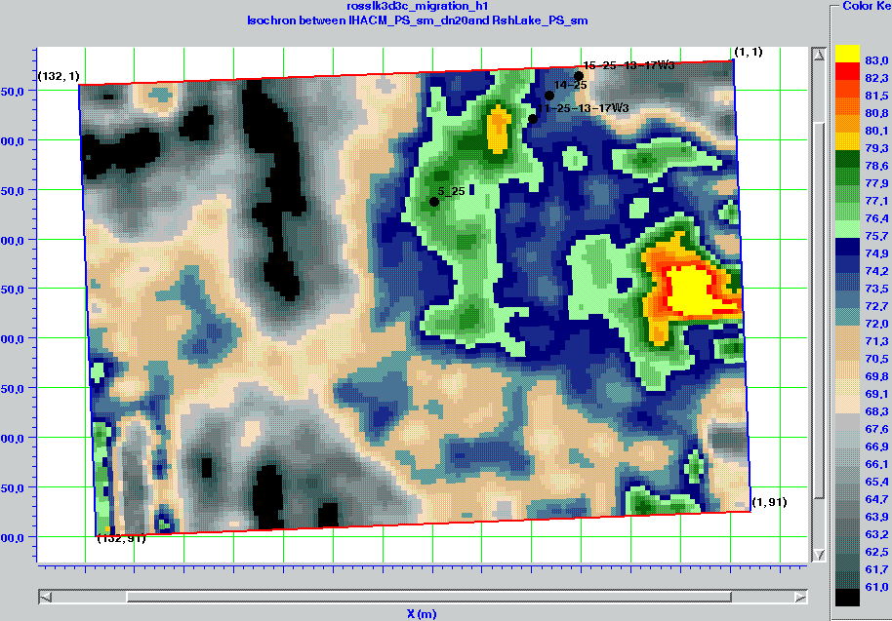
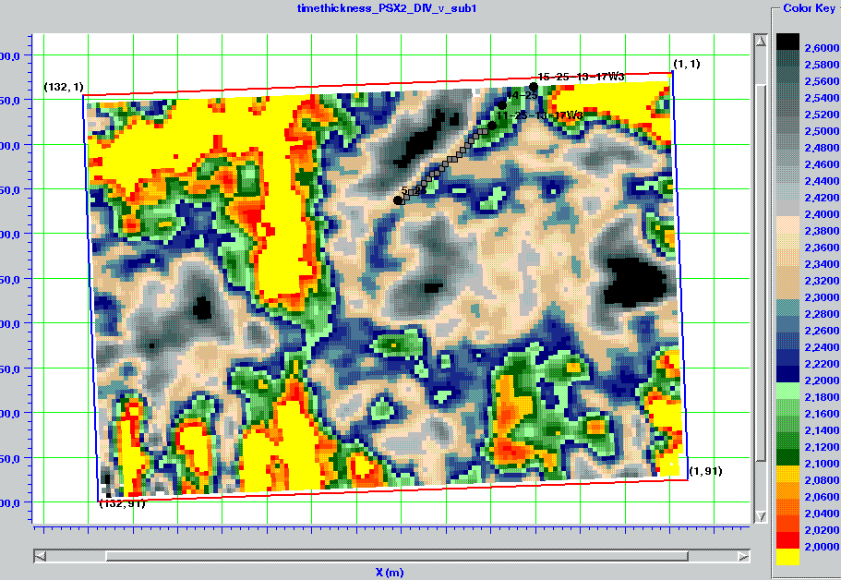
PP time thickness RushLake-IHACM
PS time thickness RushLake-IHACM
Map of average Vp/Vs between RushLake and IHACM

Slide 11
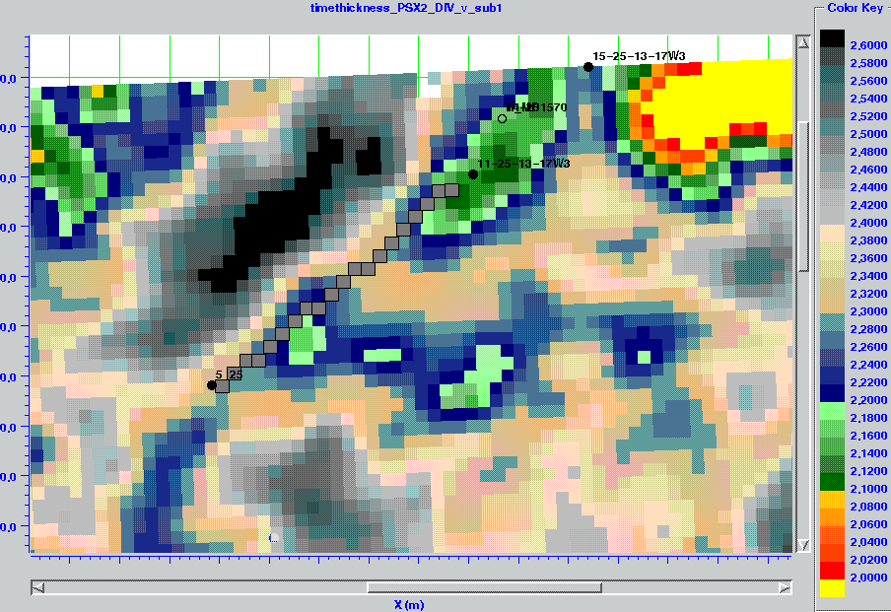
Zoom of Vp/Vs map (IHACM to Rush-Lake)
MD:1240 m
MD:1570 m

Slide 12
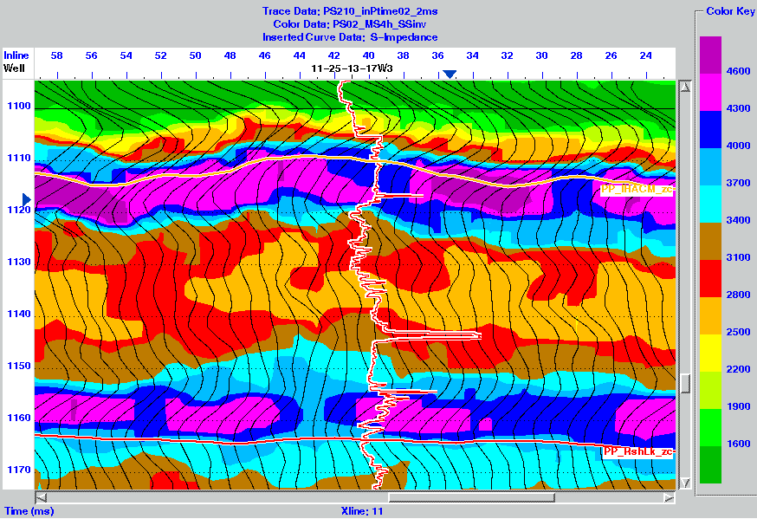
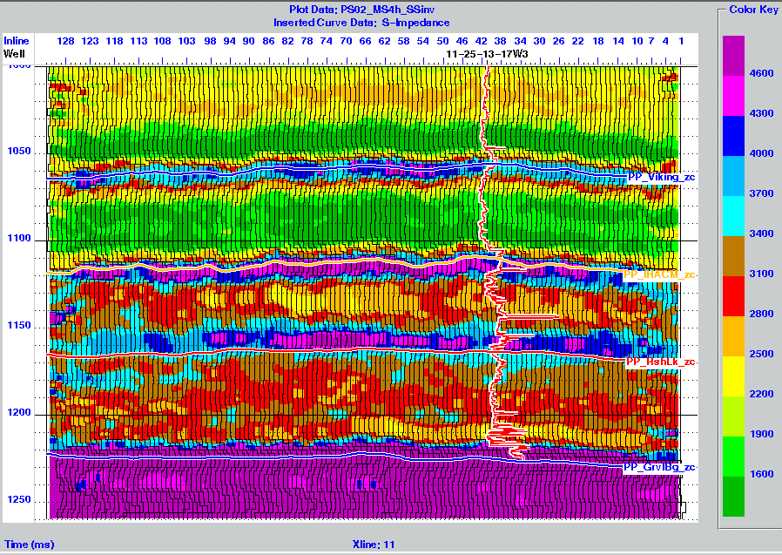
S-impedance from sparse-spike inversion

Slide 13
Comparison of traveltime and impedance Vp/Vs
Vp/Vs from time-thickness (isochron) ratios
Vp/Vs from impedance ratios

Slide 14
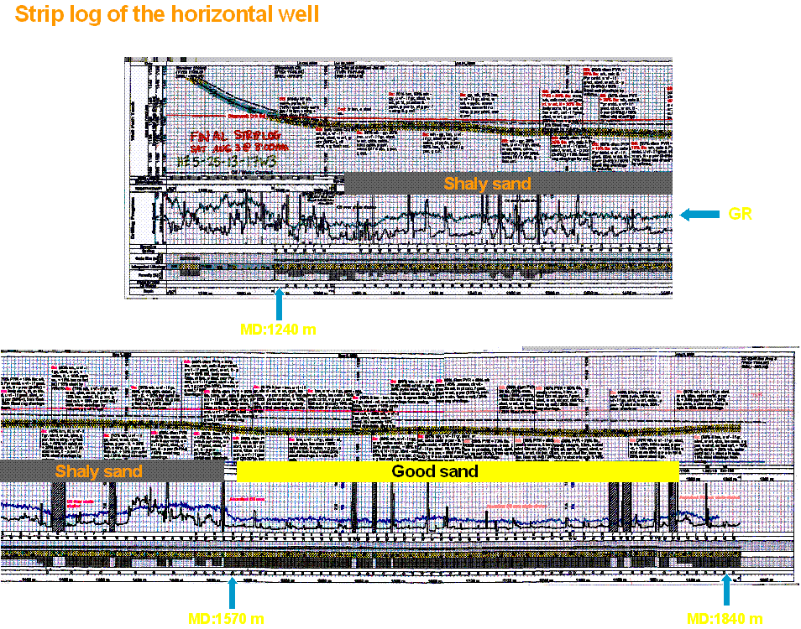

Slide 15
Horizontal well design on Vp/Vs
Proposed horizontal well

Slide 16
Summary & Acknowledgements
PP time thickness indicates channels & sand bar shape
VSP and synthetic seismograms assist in PP-PS correlation.
Vp/Vs from time thickness & inversions indicate reservoir sands
Combining and PS data provides another reservoir delineator & additional targets
Husky Energy Inc. – especially, Larry Mewhort, Kenneth Hedlin and Angela Ricci
Schlumberger – in particular, Mike Jones
CGGVeritas Hampson-Russell Software Services Ltd.
Allied Geophysical Lab, & the CREWES Project

Slide 17
Ground Penetrating Radar (GPR) and Total Station Survey in Robertson Stadium, University of Houston
Suleyman Coskun
Geophysical Data Acquisition Term Project Presentation
26 April 2012

Slide 18
Outline
Introduction
Methods
Data Acquisition
Data Processing
Results
Conclusion

Slide 19
Introduction
The Robertson Stadium is a football stadium located in University of Houston Main Campus.
Most of the stadiums have a pipeline distribution below the field in order to prevent flooding or freezing.
Our 1st objective: To map the pipeline if the Robertson Stadium has one and define its spacing and top depth.
Our 2nd objective: To map the topography of the field using Total Station

Slide 20
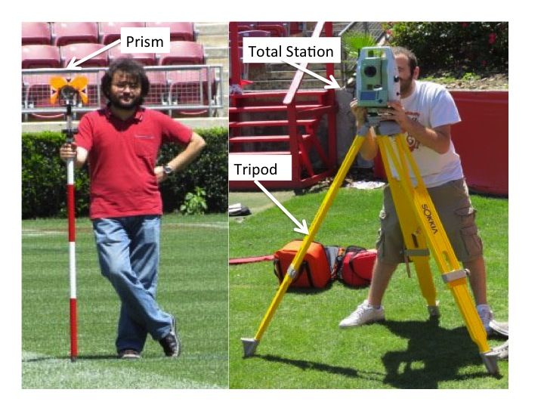
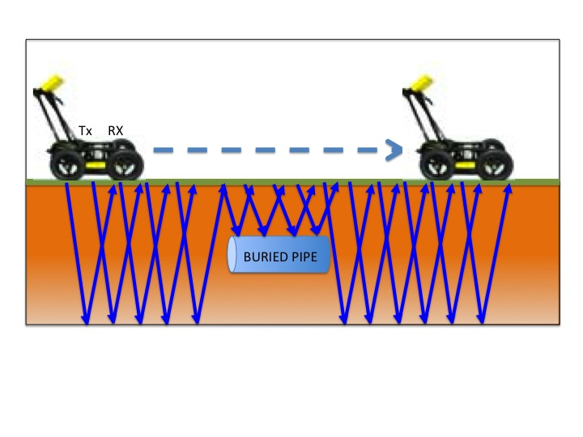
Methods
Ground Penetrating Radar
Total Station
GPR is an electromagnetic system that emits time-varying wave pulses from the surface and receives the reflections which are created by any discontinuities encountered underground.
The fundamental basis for using GPR to determine the subsurface is the relationship between the wave velocity and material’s electrical property (permittivity).
The unit of Electromagnetic travel time is nanosecond (10⁻⁹ sec)
Penetration and Resolution depend on center frequency of system antenna.
Total station is a modern surveying technique that uses electronic/optical distance measuring device and reflector.
Total station system can determine the coordinate and elevation information of a point by using simple trigonometry and triangulation equations.
It has has very high accuracy (~1.5mm).

Slide 21
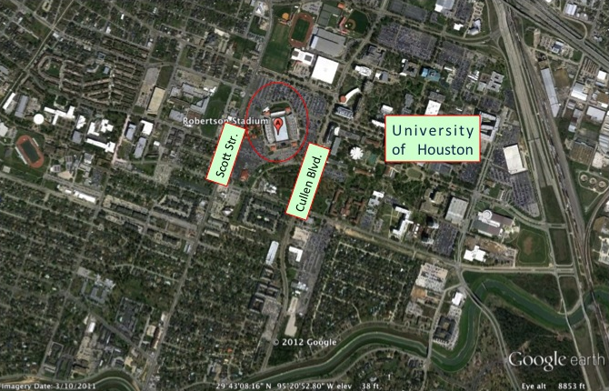
Data acquisition
Dimension of the field: 300x160 ft.
Data acquired from half of the field
GPR System : Noggin 250 MHz
Grid Line Spacing: 3 ft.
Number of stack: 32
Y line: 54 – X Line: 51
Total Line length: 16,290 ft.
Trimble Total Station System
Point Spacing:
5 yards in X direction
10 yards in Y direction
190 data point in total

Slide 22
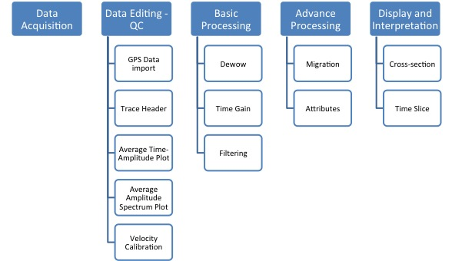
DATA PROCESSING

Slide 23
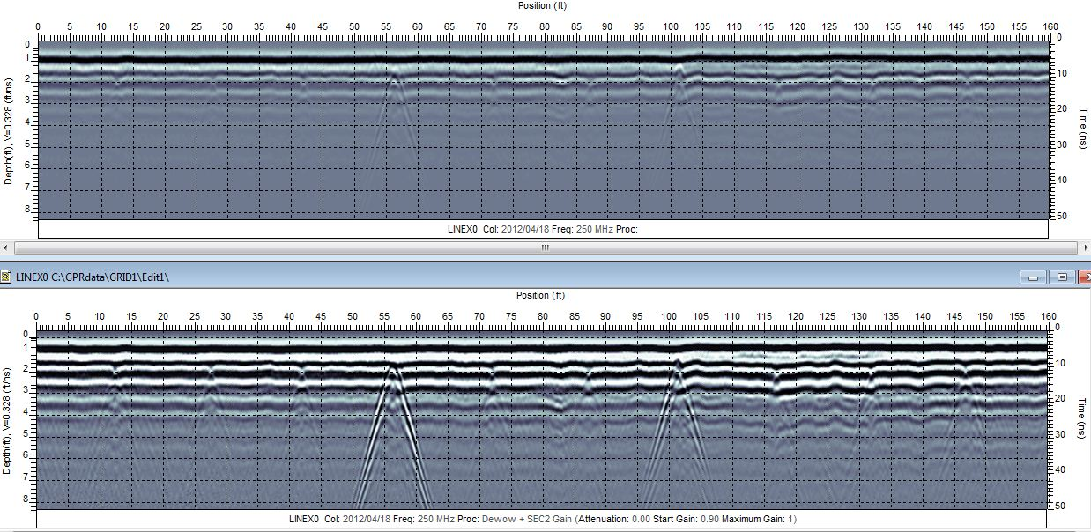
DATA PROCESSING

Slide 24
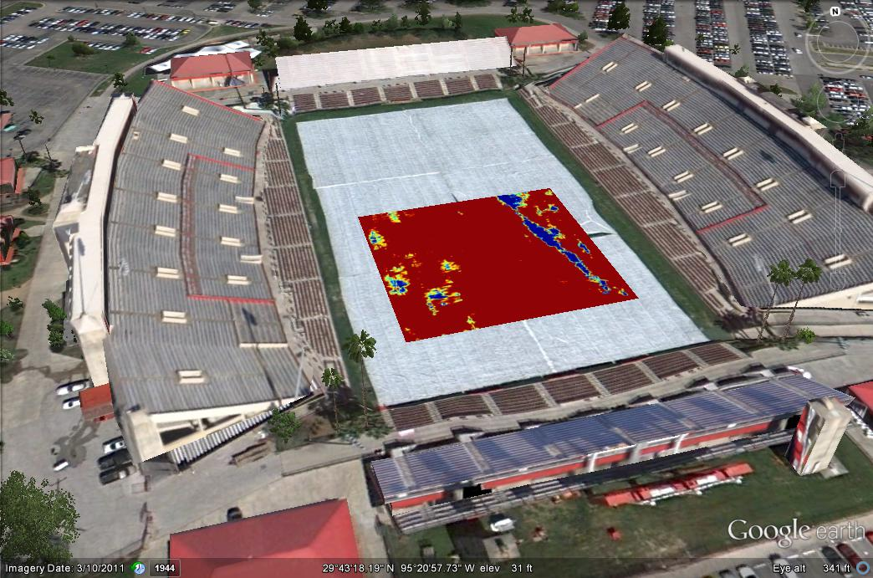
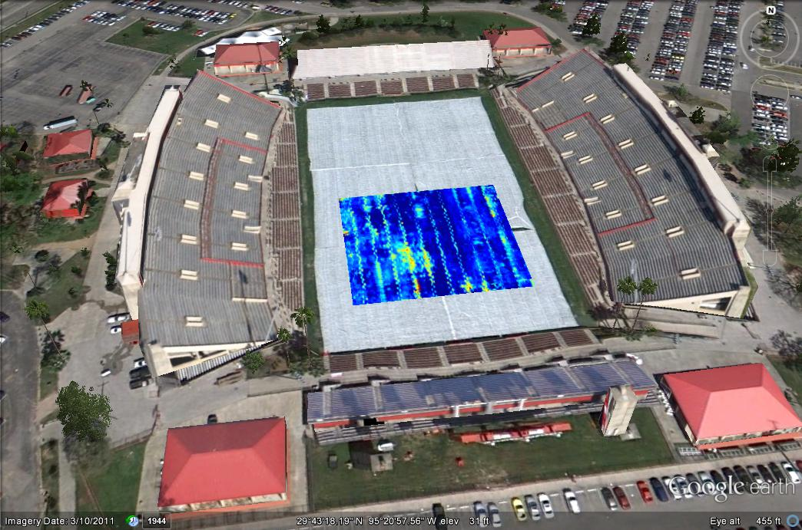
results
0.4-0.5 feet depth slice
1.7 – 1.75 feet depth slice

Slide 25
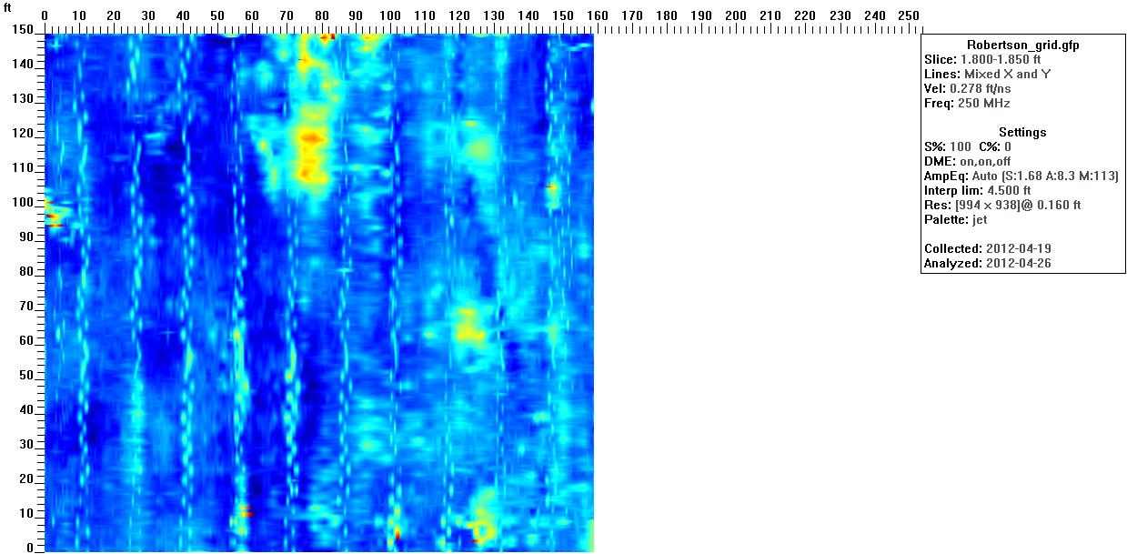
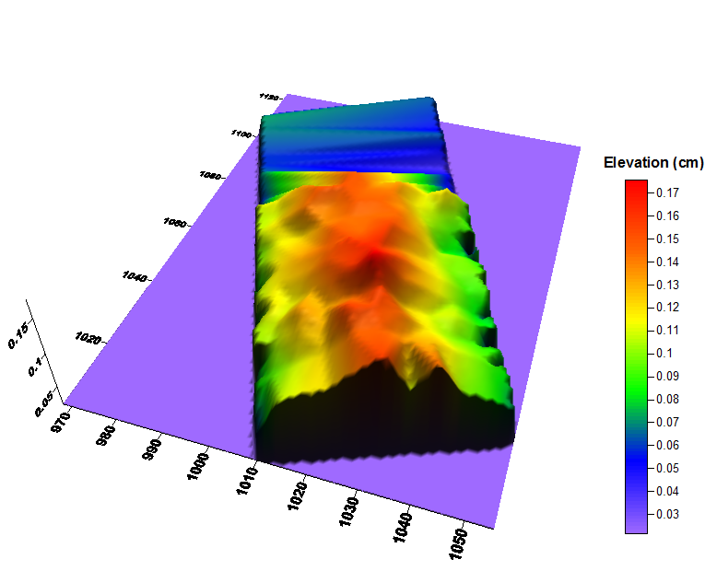
results
Inclination towards E-W
Self- drainage system?
1.9-1.95 feet depth slice

Slide 26
conclusion
Some geotechnical and topographic features of the Robertson Stadium at University of Houston are determined by ground penetrating radar and total station systems
The drainage pipeline separation is 15 ft and the pipeline distribution has a very clear image in processed GPR data.
Also GPR data indicates a shallow lineament in the East side on the study area but the source of this anomaly remains unknown.
Topographic data indicates that the stadium is inclined towards East and West directions. This inclination is interpreted as a self-drainage system that provides water to be drained from the center to the corners for preventing a flooding.

Slide 27
Thank You
Dr. Robert Stewart (Director of Allied Geophysical Laboratories)
Jeremy McDonald (Director of facilities and operations - Department of Athletics)
Susan Green, Ady Geda, Emrah Pacal and Anoop Williams (AGL)
Ozbil Yapar, Omer Akbas, Kenan Yazan and Tuna Altay Sansal (Acquisition Crew)

